Slide 1
Understanding the Consumer Buying Behavior and Communication of HBC (Hard Boiled Candy) Industry in India

Slide 2
Acknowledgement
I express my sincere thanks to Dharampal Satyapal Group with immense gratitude and respect for Mr. Vishal without whom I would not have the opportunity to serve this company. I would like to use this opportunity to thank Mr. Arvind Kumar (JGM-Marketing ), for guiding me right from the inception till the successful completion of the project. I sincerely acknowledge them for extending their valuable guidance, critical views and moral support at all the stages of this project.

Slide 3

About DS Group
The Dharampal Satyapal Group, is a rapidly growing, multi-diversified conglomerate with presence in diverse industry sectors. The Group has focused on growth & diversification with an undeterred belief in high standard product, reliability and transparency. The product portfolio of DS Group has evolved magnificently over the years and today, it has a strong presence in high growth sectors such as F&B which includes Spices and Beverages, Confectionary, Dairy, Mouth Fresheners, Hospitality, Tobacco, Packaging and Agro forestry.

Slide 4
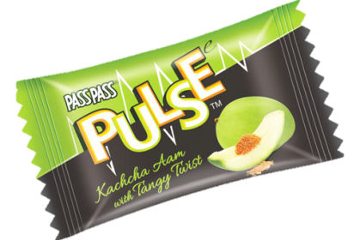
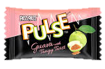
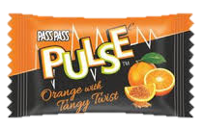
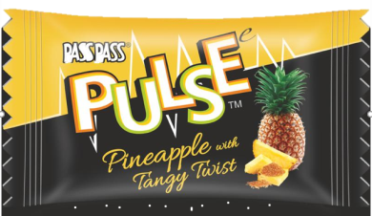
About Pulse Candy
Pass Pass Pulse, the candy from DS Group stormed the hard-boiled candy market with its launch in 2015. A category breaker in the hard-boiled candy segment ‘Pulse’ is a different experience that begins with the taste of fruity flavor and peaks with a tangy surprise. The unique and innovative combination of tastes has made Pulse stand out and become a nationwide favorite.
Pulse is available in four flavors - Kachcha Aam, Guava, Orange & Pineapple. Each flavor has the burst of tanginess, a mouth full of fun and peculiarity that is alluring. This irresistible fervor for Pulse candy is extended to the brand communication, with a tag line of ‘Pran jaaye par Pulse na jaaye’. Pulse the brand has redefined the candy category, with exceptional fruit flavors combined with a tangy core that’s driving consumers to love it so much. A taste that is so irresistible, that it has consumers wanting more.

Slide 5
Objectives
To understand and analyze brand awareness, recall and buying behavior amongst candy consumers.
To analyze the brand perception and associations of top 5 HBC brands among consumer.
To check the effectiveness of communication and mediums used by top 5 HBC brands.

Slide 6
Research Methodology
We made a questionnaire for this research which is divided into three parts which are: -
Brand Awareness
Brand Imagery
Brand Communication and its effectiveness
We took a sample size of 50 respondents out of which 25 were covered offline and remaining 25 were covered through online survey. The survey was done in Delhi-NCR only.

Slide 7
Below is the detailed scope of study and parameters which will be used to analysis:-
Brand Awareness and Buying behavior
By knowing TOM (Top of Mind) recall and their preferences for Toffee/Candy.
Which Toffee/Candy Brand they are purchasing and frequency of their purchase.
From where they are buying Toffee/Candy.
Their intent behind buying Toffee/Candy.
Brand Imagery
Brand image associations for respective brands.
Celebrity associated with respective brands.
Brand Communication and its Effectiveness
Communication recall of respective brands.
what are the sources of recall

Slide 8
Target Group (TG)
We will target 12-35 age group which will be further divided into three set of groups: -
School- 12- 17
College- 18- 21
Young Working/ Homemakers- 22- 35
*Respondent should be consuming Toffee/ Candy

Slide 9
Outcome
This study will help us to give an overview of consumers buying pattern, awareness and communication effectiveness of top 5 HBC brands.
It will help us to understand the journey of Candy consumer and scope to improve/ strengthen the same for Pulse candy.
It will help us to understand the effectiveness of media vehicles used by Pulse and scope of improvement (if any).

Slide 10

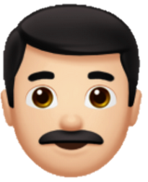
Respondent Profile Snapshot
36
8
3
3
There ae 23 male and 27 female out of 50 respondents.

Slide 11
Why do you consume Toffee/Candy?
According to this data, most of the respondents are habituated to candy which is 48% and the second most reason to consume candy is for time pass or to kill boredom

Slide 12
Which all brands come to your mind if you think a word “Toffee/Candy”?
Pulse is Top of mind brand with 36% respondents recall it as their first preference and Alpenliebe is a spontaneous brand
Spontaneous Brands
Top of Mind Brands (TOM)

Slide 13
Total recall (Unaided)
Pulse being the highest in total recall with 72% and then comes the Alpenliebe with 52%

Slide 14
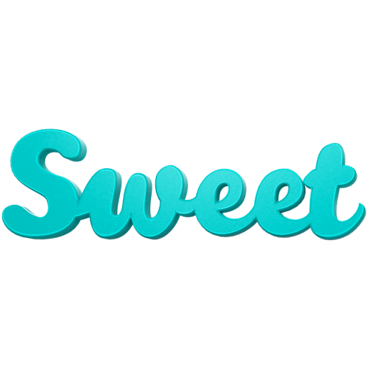
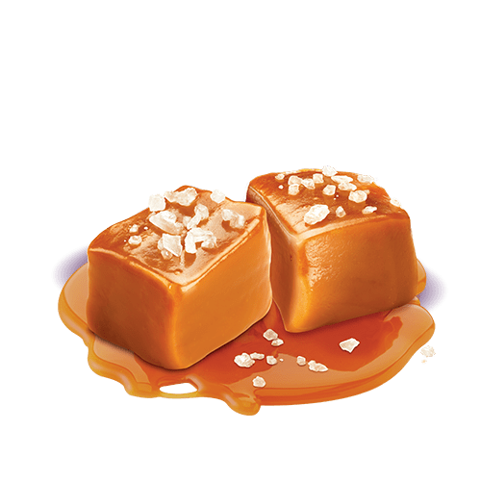
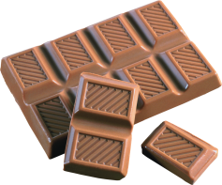

TOM Pallet Preference
Chocolate
Caramel
According to this, respondents preferer tangy flavor as their first preference but chocolate is also preferred by 31% of respondents.

Slide 15
Brand Usage Funnel
Divided in 2 parts

Slide 16
Funnel : Part 1 of 2
Currently Consuming
32%
30%
18%
Consumed L1M
70%
50%
32%
98%
88%
82%
Ever Consumed
100%
100%
100%
Aware
Pulse
Alpenliebe
Parle Kaccha Aam
According to this, respondents are aware of all three candies. The Pulse candy has more currently consuming respondents which is 32% as compare to both the candies which is Alpenliebe and Parle Kaccha Aam

Slide 17
Funnel : Part 2 of 2
32%
28%
12%
Currently Consuming
70%
38%
26%
Consumed L1M
98%
66%
54%
Ever Consumed
100%
86%
82%
Aware
Pulse
Kopiko
Candyman
This data represents, that respondents are more aware of Pulse as compare to Kopiko and Candyman and Pulse has more currently consuming people as compare to Kopiko and Candyman.

Slide 18
Consumption Pattern
Not Consuming anymore
Never Consumed
Pulse
LAPSERS
12%
This shows that Pulse is tried by everyone. Parle Kaccha has highest not consuming respondents which is 32%
0%
Alpenliebe
14%
2%
Parle Kaccha
Aam
32%
2%
Kopiko
4%
18%
Candyman
10%
22%

Slide 19
How frequently do you buy Toffee/Candy?
In a month
32%
10%
In two days
16%
In a week
42%
Most of the respondents preferer to purchase Toffee/Candy in a week. There are very less number of respondent who buy on daily basis.

Slide 20

From where do you purchase Toffee/Candy? (Not unique)
POINT OF PURCHASE CHANNELS IN ORDER
Grocery store (76%)
Chemist (44%)
College Canteen (38%)
OF THEIR PRIORITY
Pan Plus (34%)
Modern Stores (32%)
Mall (24%)
Note: All preferences are Non- unique
Most of the people buy Pulse candy from grocery stores. It is followed by chemist, college canteens and Pan Plus outlets.

Slide 21
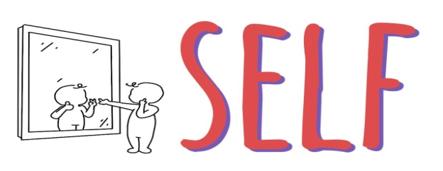

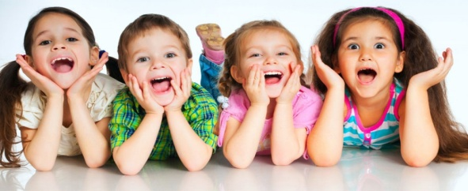
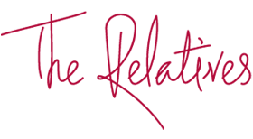
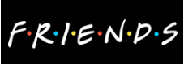
For whom you buy Toffee/Candy?
44%
29%
25%
Self
Relatives/ Friends
Children
*Others are 2%
Respondents generally buy Toffee/Candy for their own consumptions or for their Relatives/Friends.

Slide 22
Do you know different flavors of Pulse?
So according to this most of the respondent are not aware of different flavors of Pulse. Out of 50% respondents Guava flavor is most popular among respondents and favorite flavor of respondents is Kaccha Aam.

Slide 23
The best thing and scope of improvement for Pulse
Any scope of improvement for Pulse
The best thing about Pulse
“Increase the amount of masala filling”.
46%
44%
10%
“While chewing sometimes it gets stuck into teeth”.
Unique Taste
Surprise Center Filling
Initial Mango Flavor
“I would suggest you to introduce new product
like Alpenliebe Creamfills”.
“Different flavors”
“Reduce tangy content”
Most of the respondents consume Pulse because of the unique taste and the surprise Centre filling(Masala). They also want some different flavor of Pulse like Alpenliebe Creamfills.

Slide 24

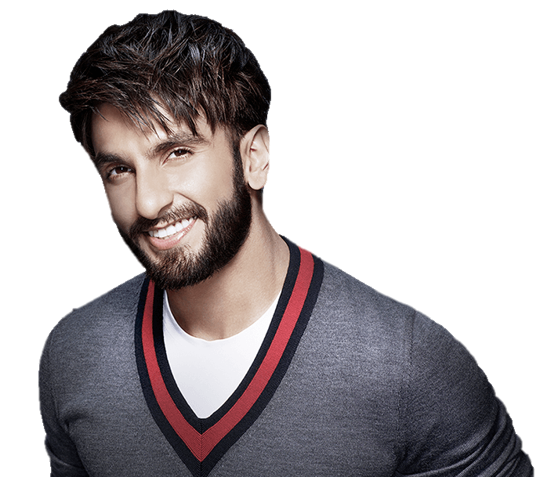

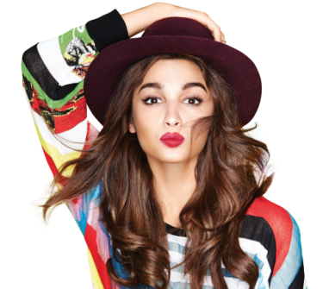

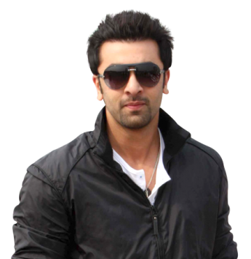
Which celebrity name comes to your mind for the Brand Pulse?
Most of the respondents relates Pulse brand with Ranveer Singh.
Ranveer Singh
Alia Bhatt
Ranbir Kapoor
Down to earth, Quirky, Full of life and energy
Modern, Ambitious, Loving, popular
Funny, witty, Modern, popular
YOUTH ICON

Slide 25
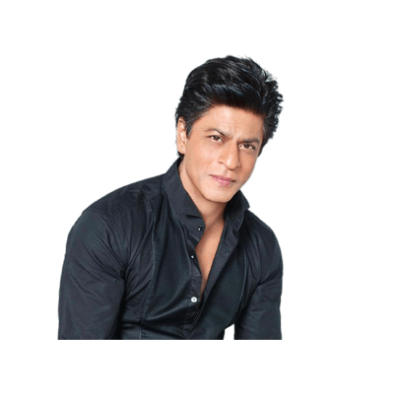
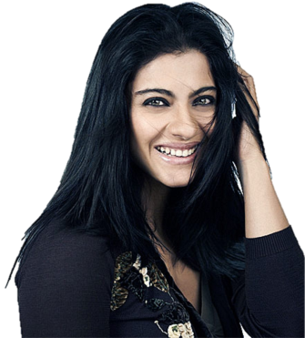
Which celebrity name comes to your mind for the Brand Alpenliebe?
Most of the respondents relates Alpenliebe brand with Kajol. It could be due to the association she had with brand over the time.
Kajol
Alia Bhatt
Sharukh Khan
Highly Creative,
Unbeatable Energy, Humble
Leadership, Ability to inspire
Modern, Ambitious, Loving, popular
YOUTH ICON

Slide 26
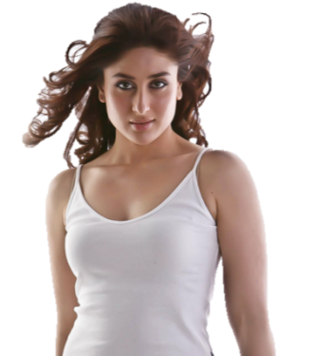
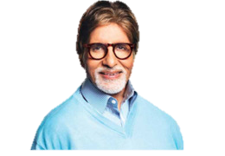
Which celebrity name comes to your mind for the Brand Parle Kaccha Aam?
Most of the respondents relates Parle Kaccha Aam brand with Alia Bhatt. The possible reason could the sweet and mischievous imagery of Parle Kaccha Aam.
However, people also relate Amitabh Bachchan with Parle Kaccha Aam because of the association he had with the brand few years back.
Alia Bhatt
Kareena Kapoor
Amitabh Bachchan
Modern, Ambitious, Loving, popular
Popular, gift of grab, witty, Creativity
Determination,
Quality of adaptation, popular
YOUTH ICON

Slide 27
Which celebrity name comes to your mind for the Brand Kopiko?
Most of the respondents relates Kopiko brand with Ranveer Singh.
Ranveer Singh
Alia Bhatt
Shahrukh Khan
Highly Creative,
Unbeatable Energy, Humble
Down to earth, Quirky, Full of life and energy
Modern, Ambitious, Loving, popular
YOUTH ICON

Slide 28
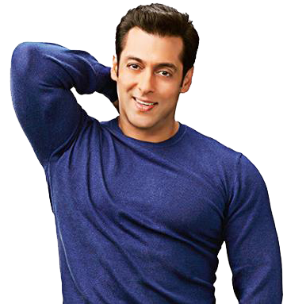
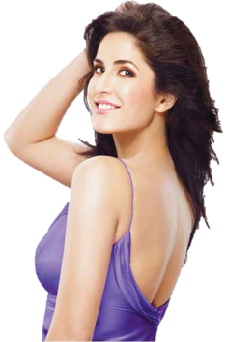
Which celebrity name comes to your mind for the Brand Candyman?
Most of the respondents relates Candyman brand with Salman Khan followed by Katrina and Ranbir.
Salman Khan
Katrina Kaif
Ranbir Kapoor
Compassion, caring, charm and charisma
Style, highly attractive
Funny, witty, Modern, popular
YOUTH ICON

Slide 29
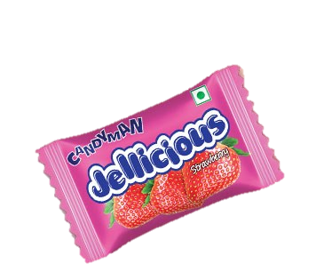

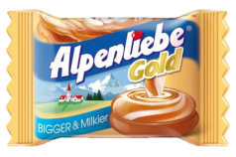
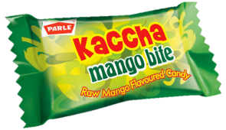
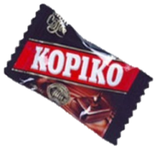
Rank of each brands on the scale of 1-10 against each statement
High quality candy brand
8.8
8
6.9
8
7.1
Distinct from other candy brands
8.9
6.3
6.6
7.9
6.1
Brand I desire
8.3
7.6
6.3
7.6
6.8
Reminds me of my
childhood
6.5
8.5
7.2
7.1
7.1
Fun and Quirky
8.3
7
6.6
7.9
6.8
Is appropriate to have on the go
8.2
7.8
6.7
8.1
7

Slide 30
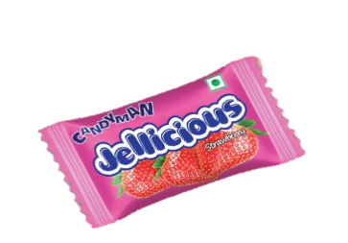
Has a unique taste
9
6.6
6.7
8.3
6.1
Is consumed after eating
6.8
7.6
6.2
8
6.5
Is easily available
9
8.9
8.1
8.2
8.1
Symbolize friendship
7.5
7.3
6.4
7.2
6.9
Irresistible
8.3
7
6.2
8.2
6.2
Loved by everyone
9.1
8.4
7
8.4
7.7
Young and Modern
9
6.2
6.4
8.4
5.7
*These No. are shown in average
*These no are in ranking 1 being lowest and 10 being highest

Slide 31
Explanation of each statement
Most of the respondents said that Pulse is a high-quality candy brand and then comes Alpenliebe and Kopiko
Pulse and Kopiko both got highest ranking in terms of “Distinct from other candy brands”
Most of the respondent’s desire Pulse as their first brand and then Alpenliebe and Kopiko
Alpenliebe and Parle Kaccha Aam got highest ranking in terms of “Remind me of my childhood”
Majority of respondents get “Fun and Quirky” from Pulse and then Kopiko
Majority of respondents said that Pulse and Kopiko is appropriate to have on the go

Slide 32
Most of the respondents think that Pulse and Kopiko has a unique taste
Most of the respondents consume Kopiko and Alpenliebe after eating
Pulse and Alpenliebe are easily available to the respondents
Most of the respondents think that Pulse and Alpenliebe symbolized friendship
Majority of respondents said that Pulse and Kopiko have irresistible taste
Pulse, Alpenliebe and Kopiko are loved by everyone
Pulse and Kopiko got highest ranking from respondents in terms of “Young and Modern”

Slide 33


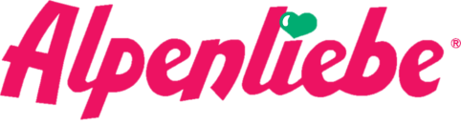
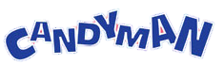
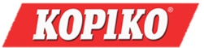
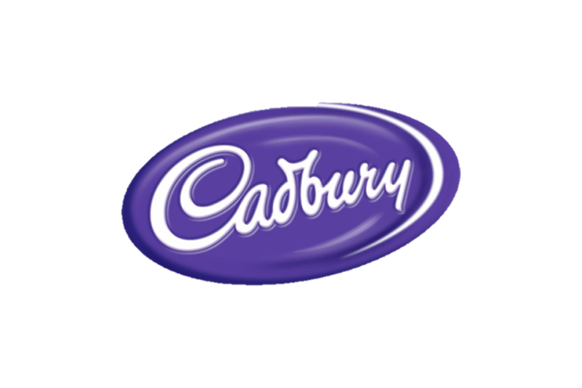
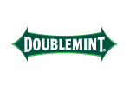
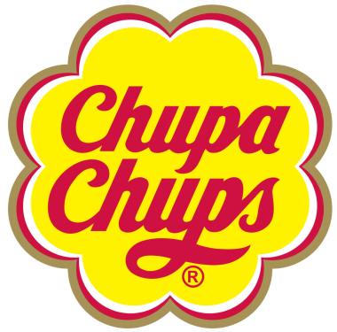

Which Toffee/Candy Commercial did you see last and where?
TV | 39%
TV | 12%
Online| 2%
TV | 12%
Newspaper | 2%
TV | 7 %
TV | 5%
TV | 2%
Online| 5%
TV | 2%
TV | 2%
TV | 2%

Slide 34
Did you see Pulse advertisement and where?
Out of 78%
While Majority of respondents saw Pulse advertisement and in which 47% respondents saw it on Television, 14% and 6% saw on online, Posters respectively.

Slide 35
What was Pulse ad about?
“A group of friends act as if their house has caught fire just to scare one of the friends to take out all the candies he has hidden in different corners of the house”
”Pulse me chupe tangypan Ka har koi dewaana hojaye pran jayee par pulse na jaye”
“Girl try to convince boy she had break up and she feels for that boy but boy said he finished last pulse candy”
The ending part of the TVC
“Office TVC”
First TVC of Pulse
Office TVC
Second TVC of Pulse

Slide 36
Tagline of each brand
Pulse
“Pran Jaaye Par Pulse Na Jaaye”
Alpenliebe
“Jee Lalchaye Raha Na Jaye”
Parle Kaccha Aam
“Kaccha Aam ki Xerox copy”.
Candyman
“Kuch Bhi Karega for CANDYMAN”
Kopiko
“JAAGE RAHO. AAGEY RAHO”.
“Real Coffee Anytime Anywhere”
“Stay Awake, Stay Ahead”
37% respondents know about Pulse tagline and only 26% respondents know Alpenliebe tagline

Slide 37
Suggestions for the brand Pulse
Flavour Awareness The brand can focus on tactical communication with respect to flavours. May be create more TVC’s , POSM, Outdoor visibility can be worked out.
Product improvement It was observed that 15% of the respondents know Pineapple flavor but pineapple is not liked by anyone of the respondent. So, this suggest that pineapple flavor can be improved basis further detailed market research.
Sweet spot Sweet is one of the major preferred flavour pallet but with Pulse DS group only caters to consumers who love tangy. DS Group can work on caramel /chocolate based candy under a different brand name.

Slide 38
Recruit Lapsers There are 12% of respondents which are not consuming Pulse any more. Brand should work towards recruiting them again may be by creating the emotional bond again or working of product basis their feedback.
Weekly Consumption Study also suggest that people generally by Toffee/Candy in a week. So, Pulse can come up with a multiplies pack of 5-10 candies .
A face to the brand In order to generate salience after a certain period, Pulse also can appoint Ranveer Singh as its brand ambassador.
Ticking Social calendar Pulse can increase their relevance in consumer lifer by becoming more active on digital space like Cadbury is doing.

Slide 39
Annexure
http://www.dsgroup.com/aboutus-overview.aspx
http://passpasspulse.in/
Images- https://www.google.co.in/

Slide 40
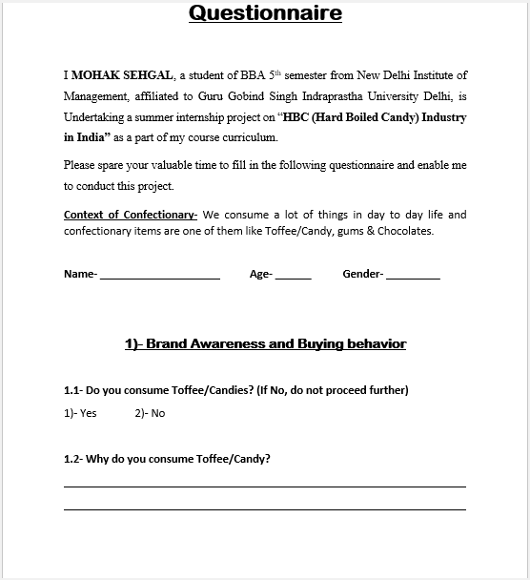
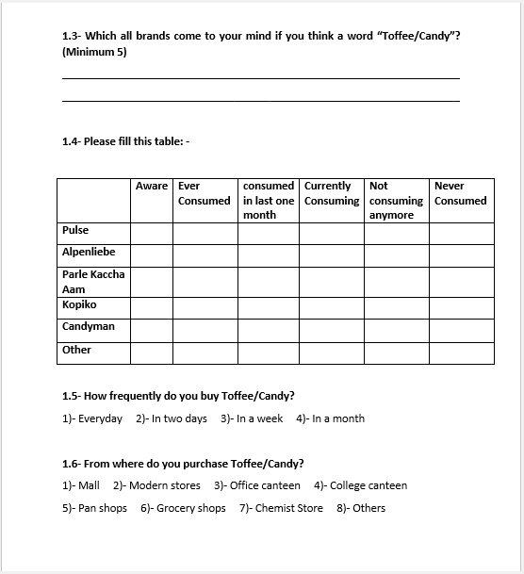
Questionnaire: Part 1 of 1
Questionnaire: Part 1 of 2

Slide 41
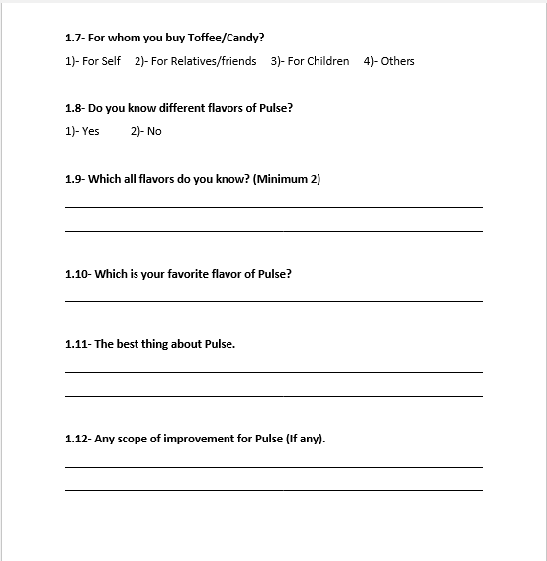
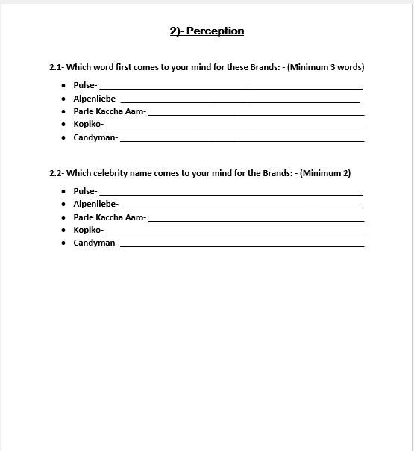
Questionnaire: Part 1 of 3
Questionnaire: Part 1 of 4

Slide 42
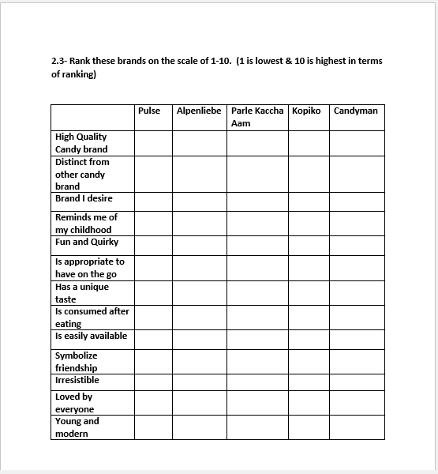
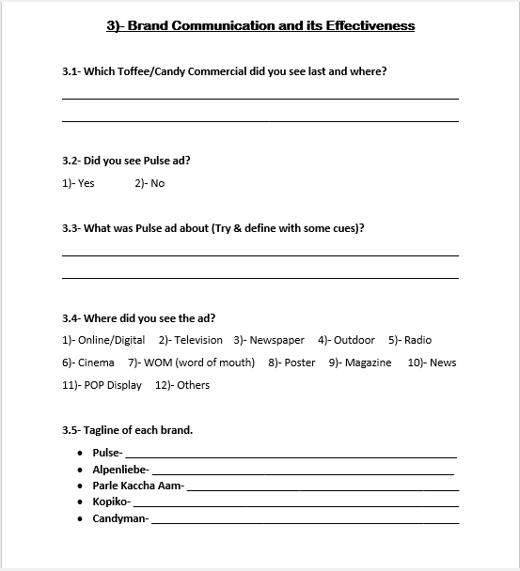
Questionnaire: Part 1 of 5
Questionnaire: Part 1 of 6

